Slide 1
Capstone Project File Handling & String Manipulation
Submitted By Date of Submission
Mamta Urade 24 Nov 2022

Slide 2
Here's the Problem Statement:
Project: File handling and string manipulation
A sample script of Game of Thrones was taken from the page and stored in the file conv.txt in the dataset provided. Your task is to read the file and do the following:
1. Find out the number of unique characters in the sample conversation?
2. Create a new text file for each of the characters with their name and store the unique words said by them in their respective file. Store one word in one line

Slide 3
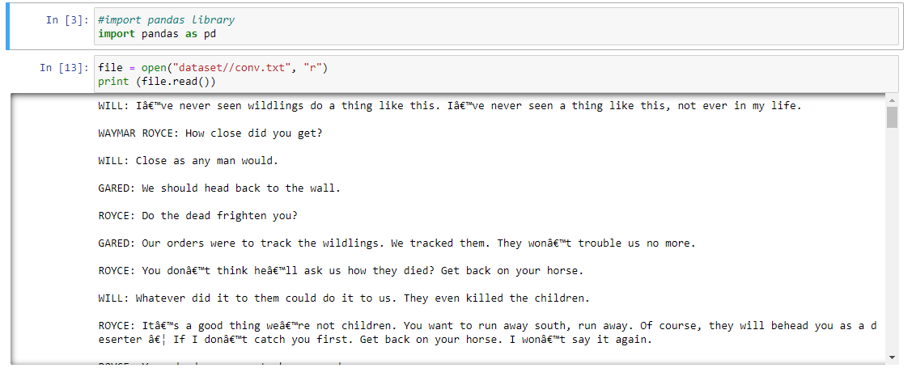
Basic checks

Slide 4
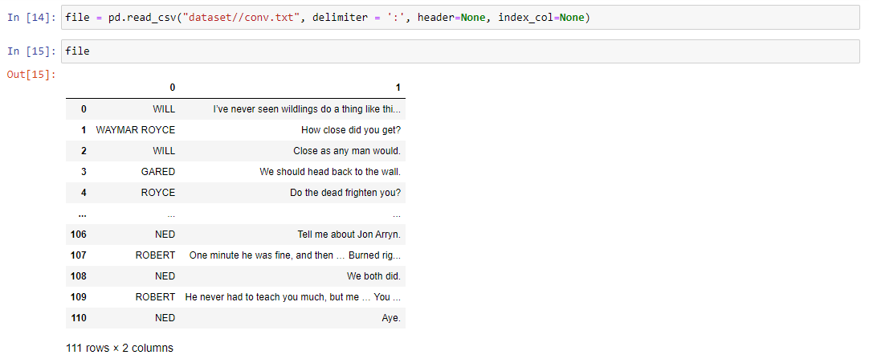
We can get the conv.txt file in the above formate using delimiter.

Slide 5
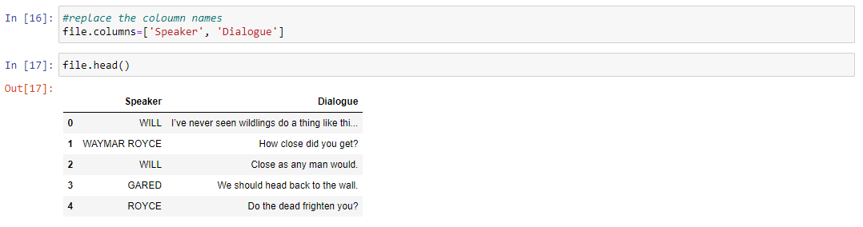
Here, we replace our column names as speaker and dialogue.

Slide 6
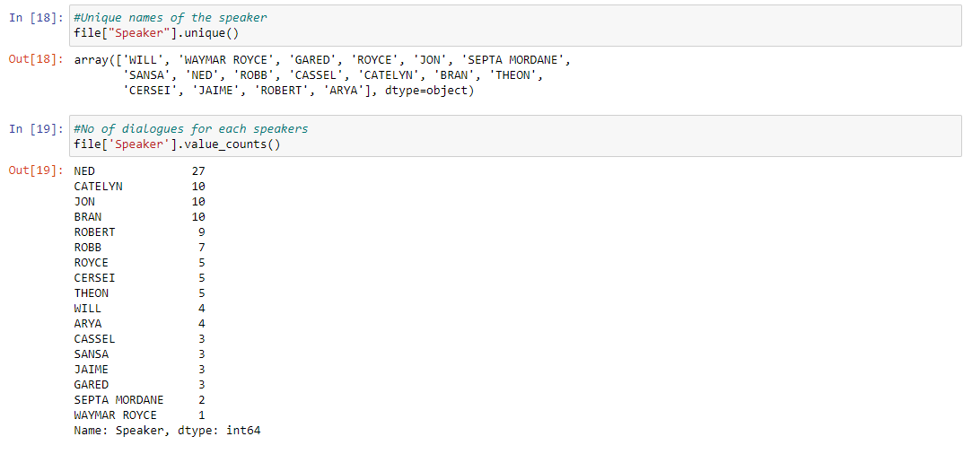
Here we get the all speakers unique name and each speaker have how many words using value count .

Slide 7
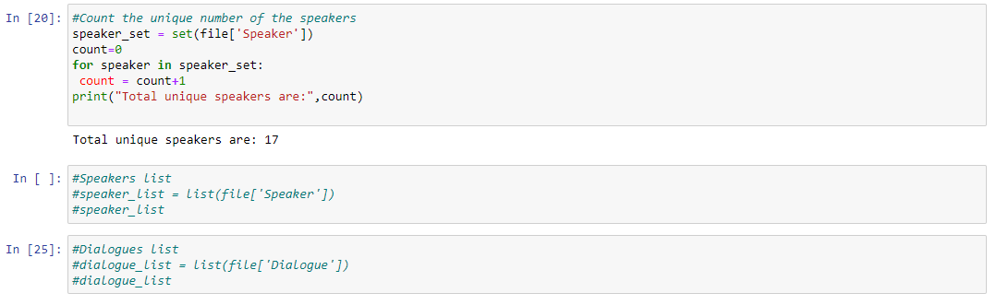
By using count function we get the unique number of speakers value.

Slide 8
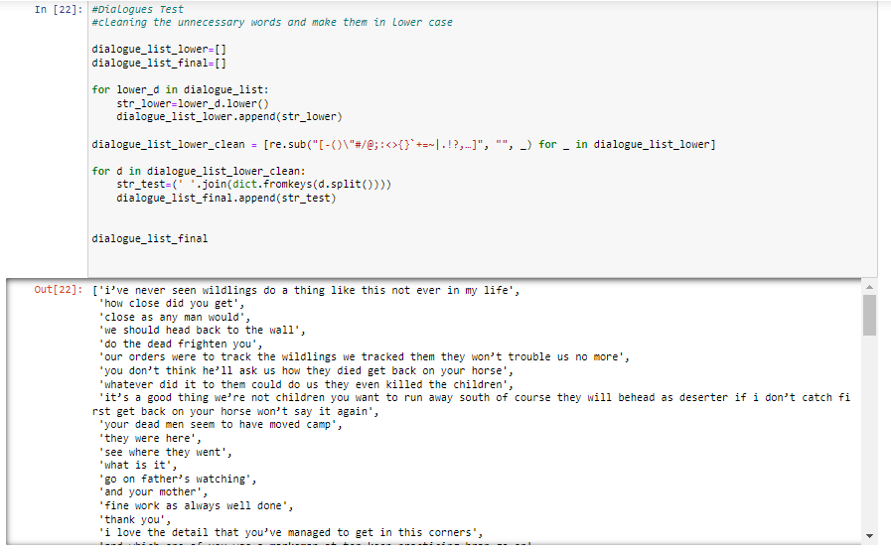

Slide 9
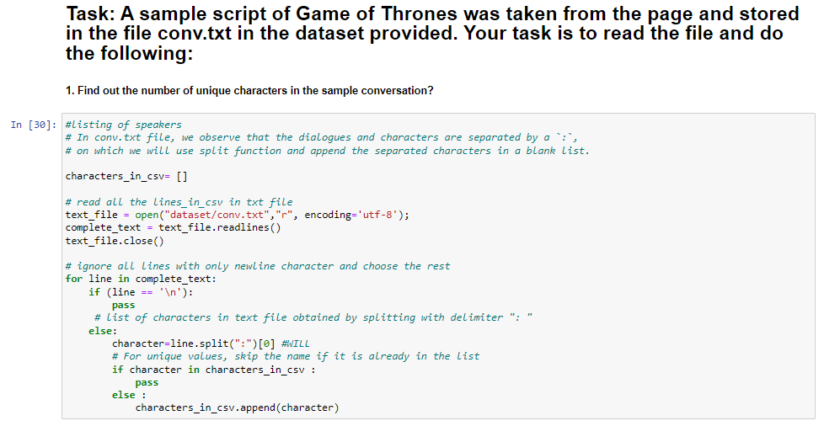

Slide 10
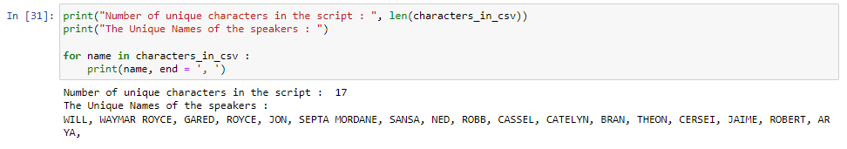

Slide 11
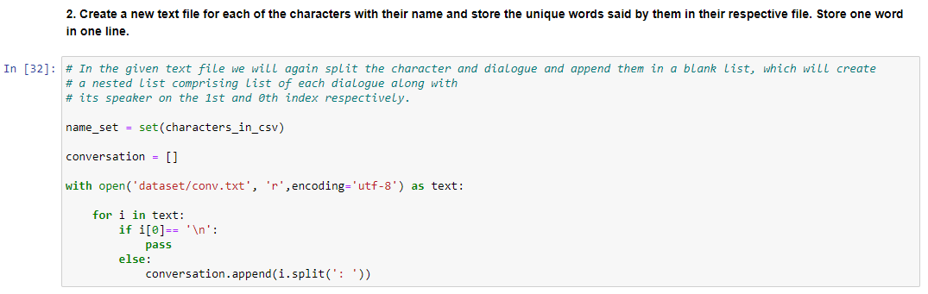

Slide 12
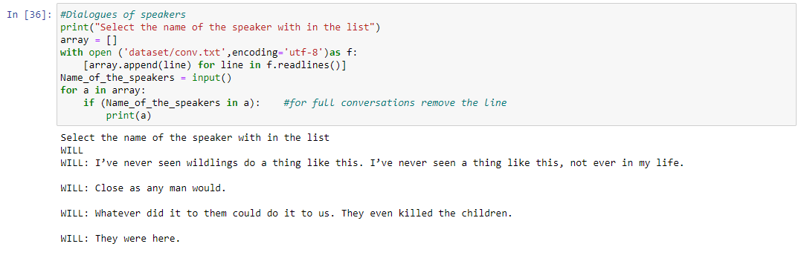

Slide 13
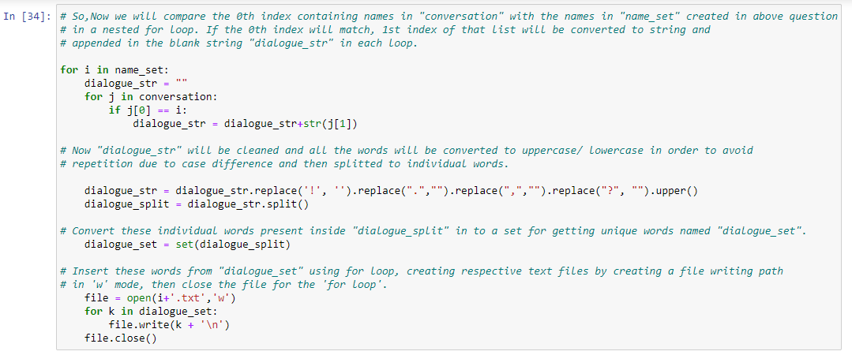

Slide 14
Conclusion
According to the Problem statement, we come up with some results. These results performing various file operations, such as reading, writing, and appending information.
File handling helps us to provides a mechanism to store the output of a program in a file and to perform various operations on it.
Python too supports file handling and allows users to handle files i.e., to read and write files, along with many other file handling options, to operate on files.
Python supports file handling and allows users to access and manipulate files using the Python program.

Slide 15
Thank you

